Slide 1
Autism Rates in America
Joshua Place

Slide 2
What is Autism?
Autism Spectrum Disorder, or ASD, is a neurological condition that affects the way certain people communicate, interact, and think. Because it is a spectrum, each autism case is unique in its own way and is usually diagnosed by how much support is needed.
Some common challenges that those on the autism spectrum face include:
Hypersensitivity or hyposensitivity to light, sound, smell, touch, etc.
Difficulty with social interactions (i.e. reading social cues, maintaining eye contact, or understanding sarcasm)
Inability to process changes to routines
It’s important to remember that not everyone on the spectrum deal with these challenges (or they deal with them in different ways,) and each case must be studied individually in order to gain a better understanding.

Slide 3
Which begs the question…
Using gathered data of autism diagnoses in children from 2000 to 2022, how can we predict how much the rate of future diagnoses will change in order to prepare special education programs at schools?
DISCLAIMER: The datasets used for this presentation are of reported cases of autism; due to underreporting, they may not accurately reflect a true accounting or a consistent sampling of true cases.

Slide 4
How can we approach this?
First, we need to visualize how much autism diagnoses have changed from 2000 to 2022.
We gathered a large dataset from the CDC website that details the rates of autism diagnoses in the United States.
We then split the dataset into 52 individual datasets (all 50 states, including DC and Puerto Rico)

Slide 5
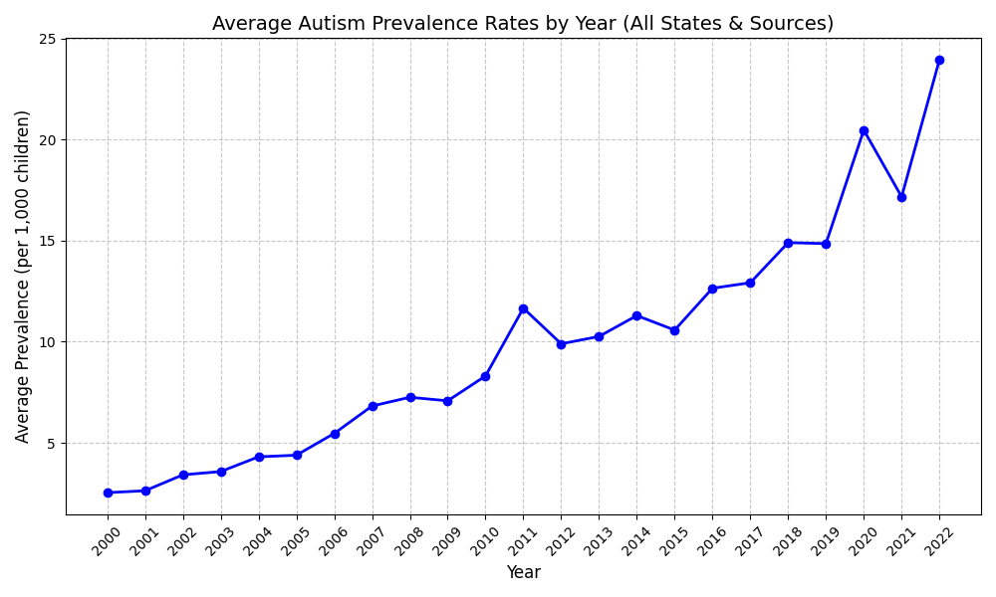

Slide 6
Causes for Autism
Autism rates have increased due to improved screening tests, diagnosis criteria, and an overall better understanding.
No singular cause; an advanced combination of countless environmental, premetal, and most importantly, genetic factors
Those who are on the spectrum are more likely to form connections with others on the spectrum than with those who are not.

Slide 7
What’s next?
Next, we split the dataset into 52 individual datasets (all 50 states, including DC and Puerto Rico)

Slide 8
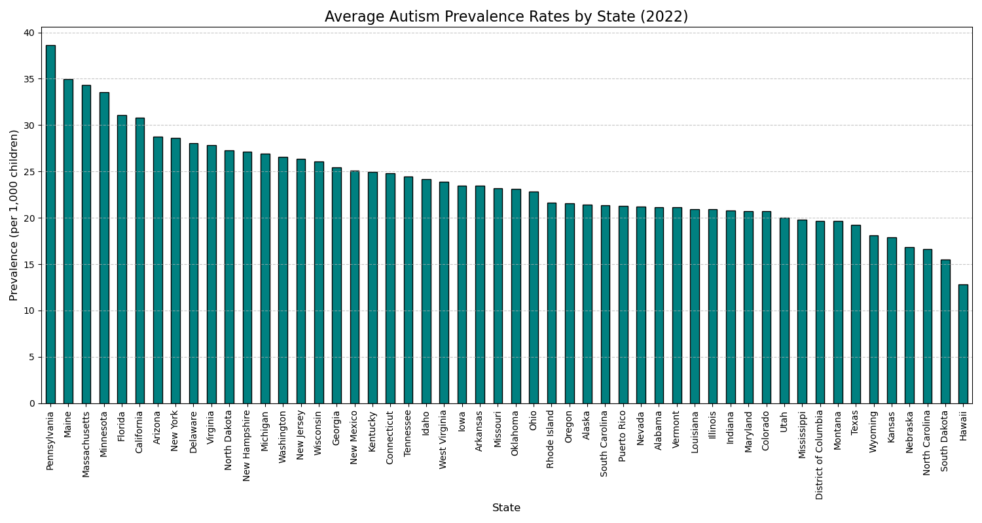

Slide 9
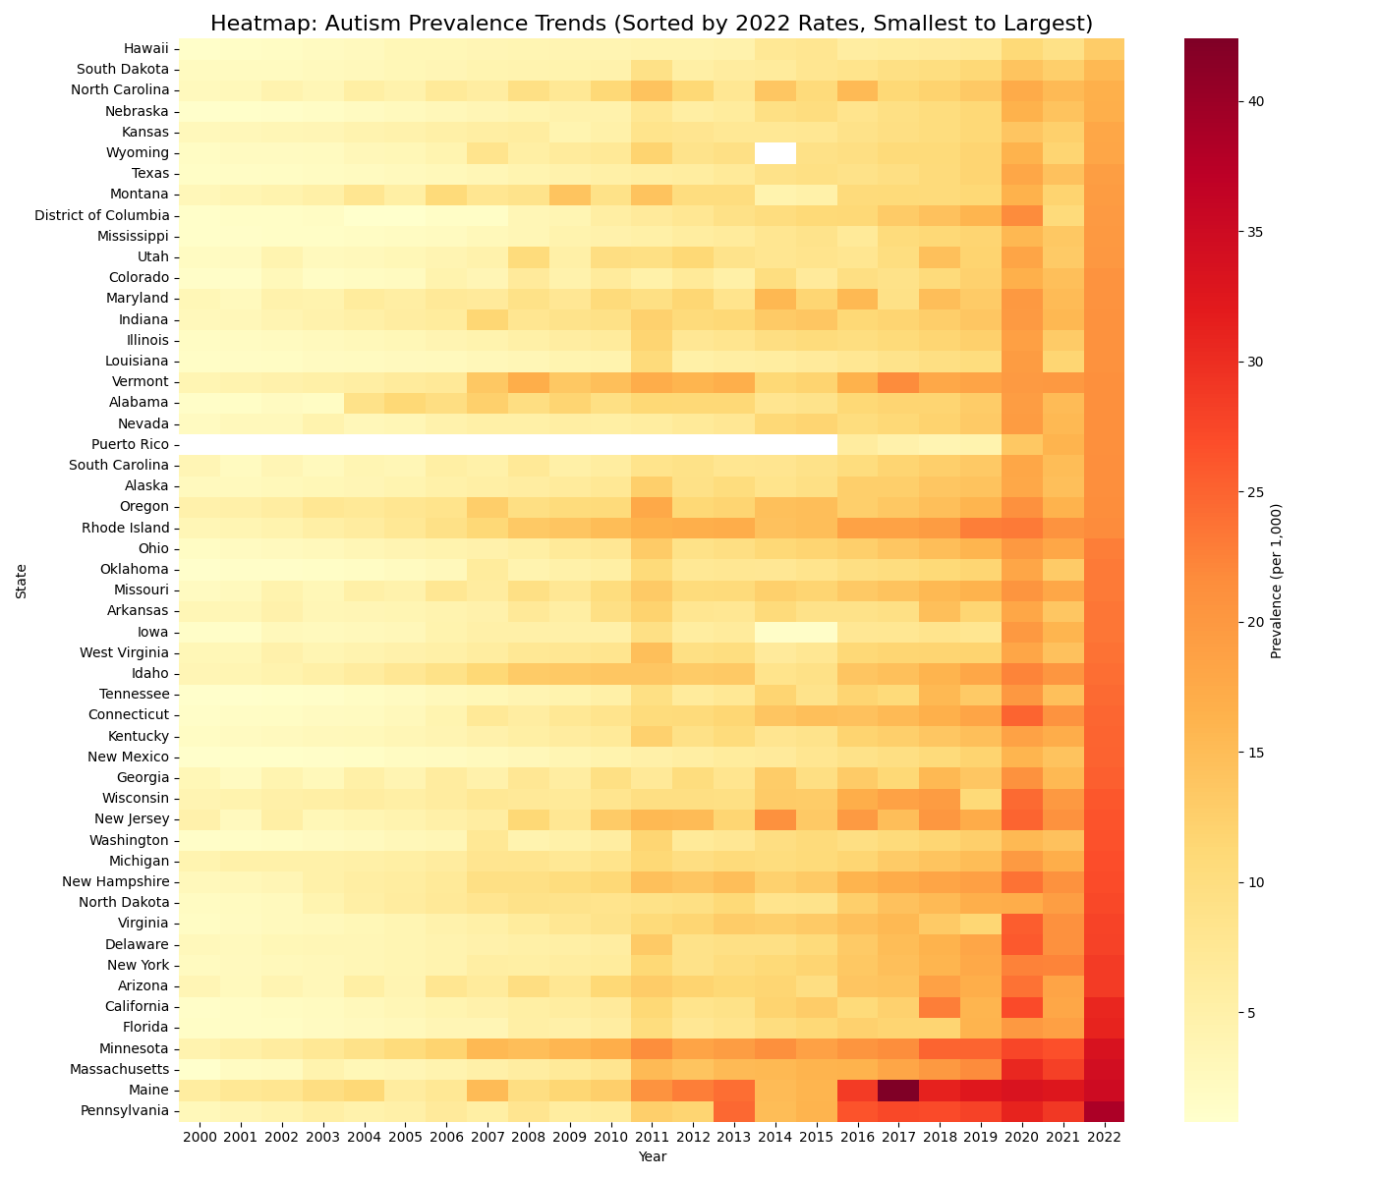

Slide 10
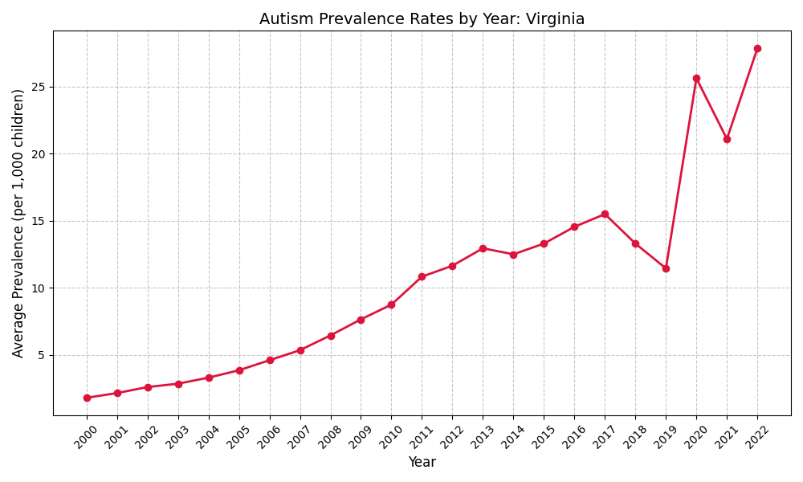

Slide 11
How can we use these findings?
Now, we can use regression to determine how much the rates of autism diagnoses in children will increase in the following years.
First, we’ll linear and polynomial regression, and then ridge regression to determine the accuracy of the data. Finally, we’ll observe correlations between the variables and determine what they could mean.

Slide 12
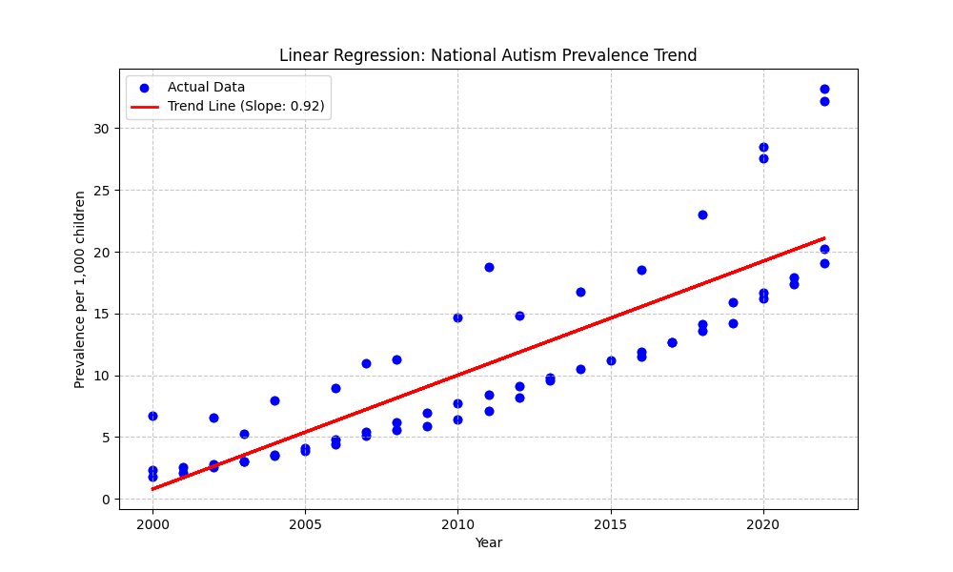

Slide 13
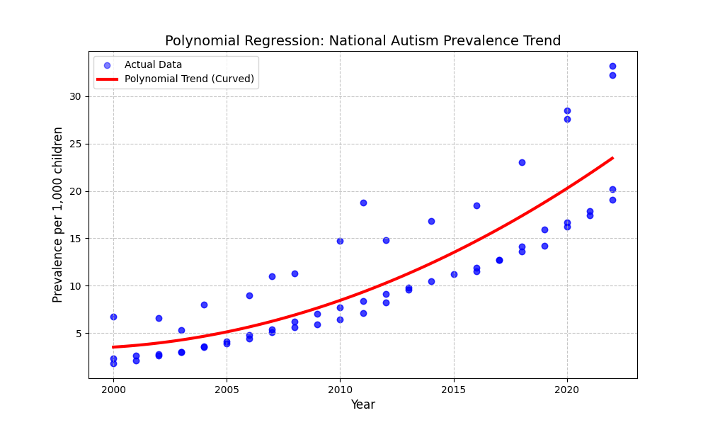

Slide 14
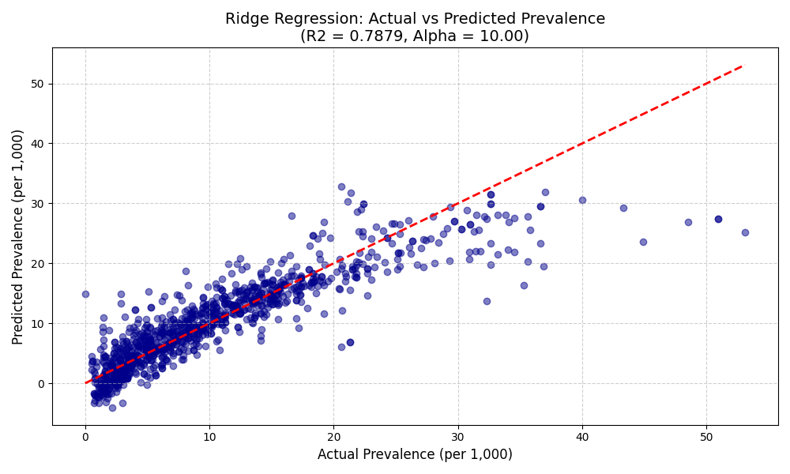

Slide 15
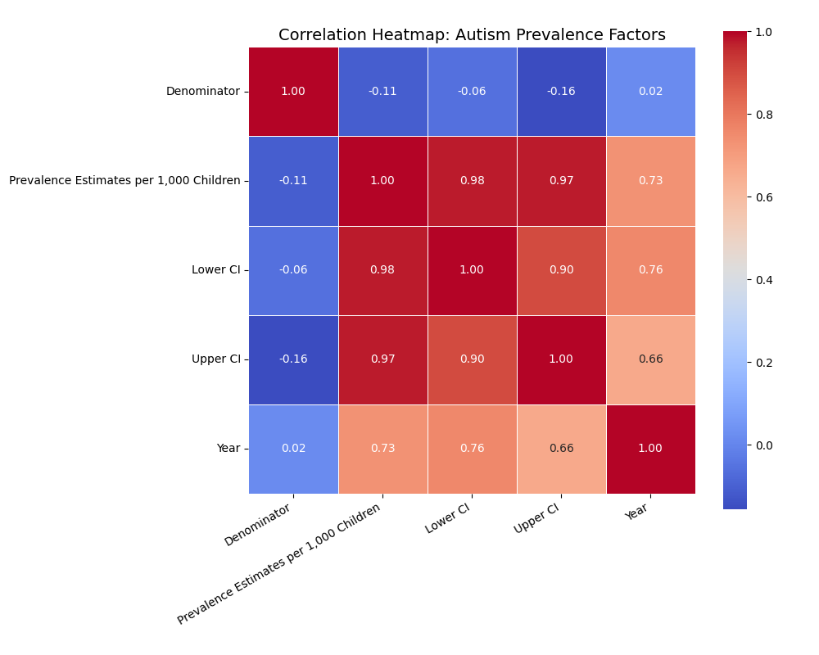

Slide 16
Notable Correlations
Year vs Prevalence = 0.73
As the years go by, the rate of autism diagnoses increases substantially.

Slide 17
Notable Correlations
Year vs Lower/Upper Confidence Intervals = 0.76/0.66
Not only will the diagnosis rates continue to rise over time, but the range of estimates will also continue to rise.

Slide 18
Notable Correlations
Denominator vs Prevalence = -0.11
The size of the sample groups (i.e. states) have little effect on the rates of autism diagnoses: the percentages stay consistent across each sample group.

Slide 19
What can we gather from this?
Autism diagnoses will undeniably continue to increase as the years go by now that we have a better understanding and acceptance of the spectrum, meaning we need to better prepare our education system to accommodate children with autism.
It’s incredibly important to remember that each case of autism is different in one way or another, and because research in autism has stagnated in the past year, we are at the risk of lagging behind in assisting children with autism in the classroom.
Autism is not a mystery with one solution that needs to be solved; it’s a spectrum of conditions that need to be understood and accommodated.

